Slide 1
CYBER SECURITY UPSKILLING PROGRAM قدم خلال مبادرة زنك/2 في جامعة البلقاء التطبيقية بالتعاون مع أكاديمية سايبر شيلد SEP 2024 Nmap & Ethical Hacking Part Version 1
INST.:ENG.ALI BANI BAKAR-0778642376(CYBER SHIELD ACADEMY)
DONE BY: ENG. Dana Al-Mahrouk-0798697842-BAU.UNIV.

Slide 2
Nmap
-p → port
-sn → no port scan
-Pn → no host scan
-sS → half scan + no host scan
-O → OS Version
-sV → Port Version
-f → fragment packets
-T → Time
-D → decoy scan
-g → Src Port change
-sT → TCP scan
-sU → UDP scan
-sC → nmap Default Script
--script → nmap script

Slide 3
Day 13
Outline
Nmap
Kali + metasploitable
Nmap + wireshark
Nmap network + device
Host scan
Port scan
Option
-p → port
-sn → no port scan
-Pn → no host scan
-sS → half scan + no host scan

Slide 4

Nmap (Network Mapper)
is a powerful tool used for network discovery and security auditing.
Nmap supports many advanced scanning techniques, including:
port scanning
OS detection
version detection
vulnerability scanning

Slide 5

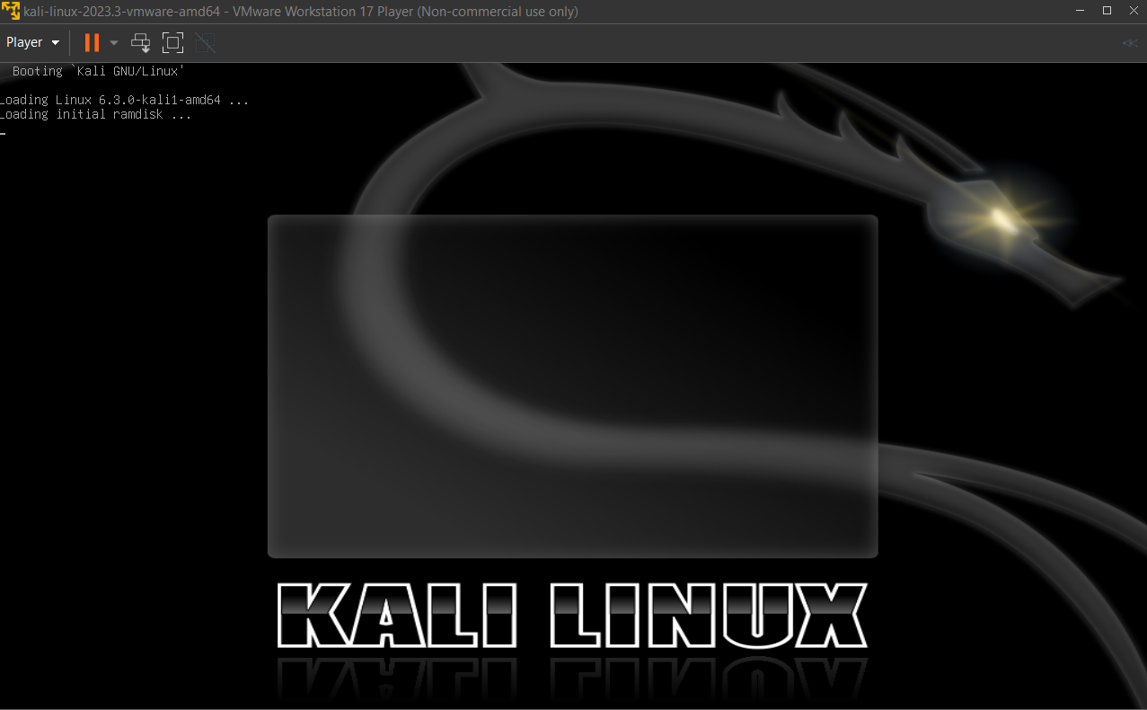
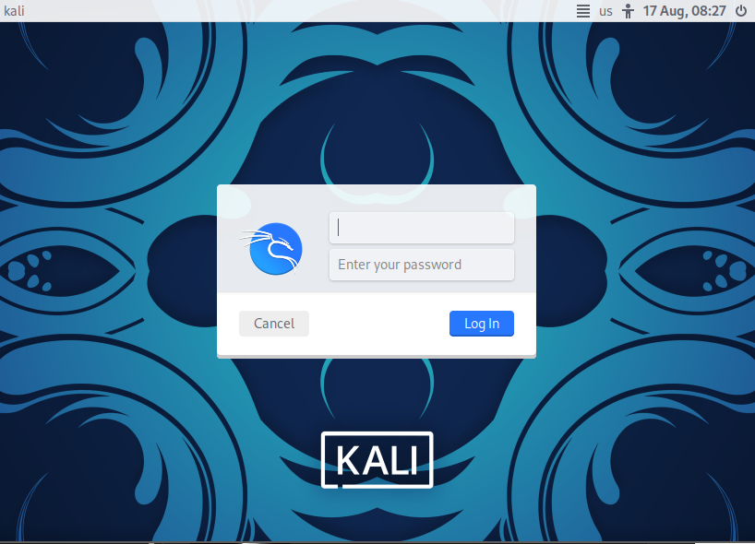
Kali ➔ 192.168.186.130/24

Slide 6
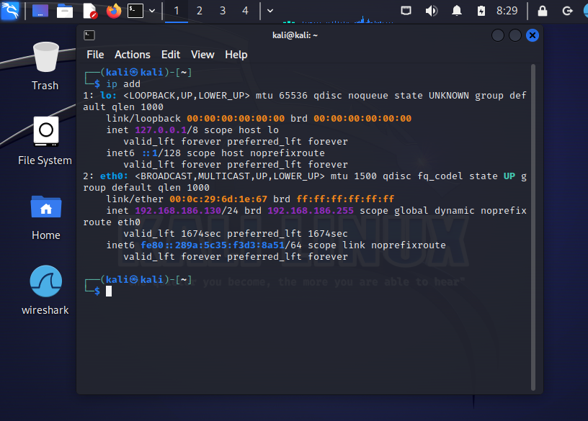
Kali ➔ 192.168.186.130/24
ip address:
display or configure IP addresses on network interfaces.

Slide 7

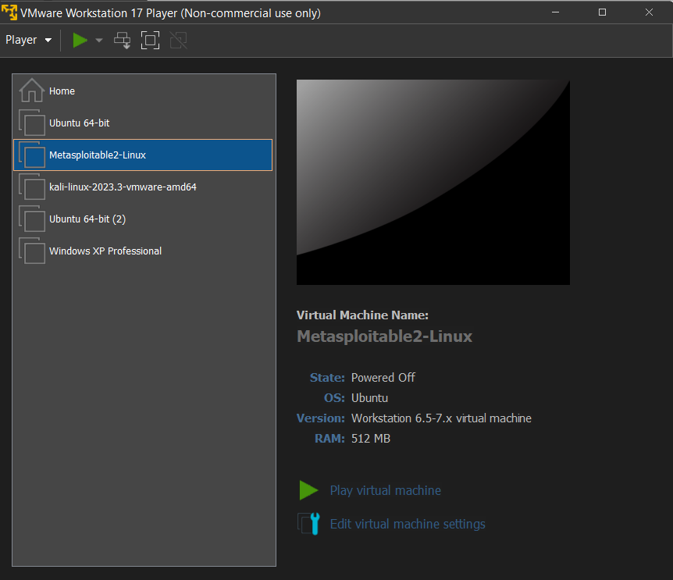
Metasploitable
is a deliberately vulnerable virtual machine (VM), primarily designed for educational purposes.
It's often used as a target machine to practice and demonstrate security tools like Metasploit.
The goal of Metasploitable is to provide a safe environment where ethical hackers and security professionals can do their skills in penetration testing without attacking real systems.

Slide 8
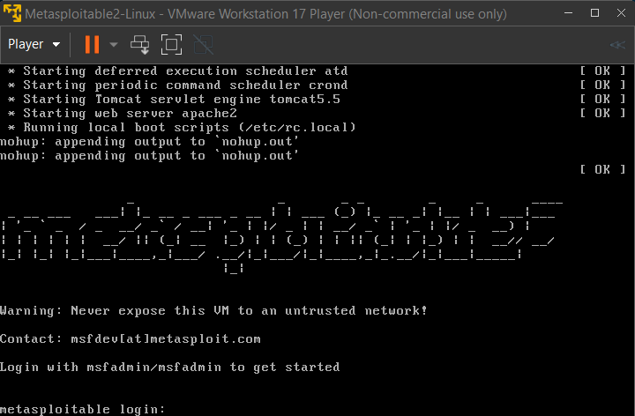
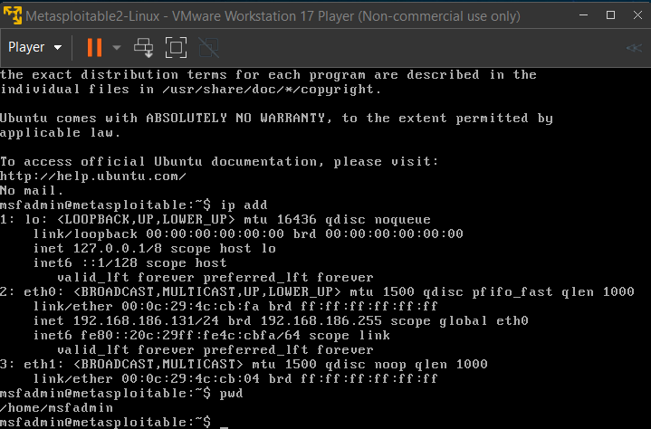
Metasploitable ➔ 192.168.186.131/24

Slide 9
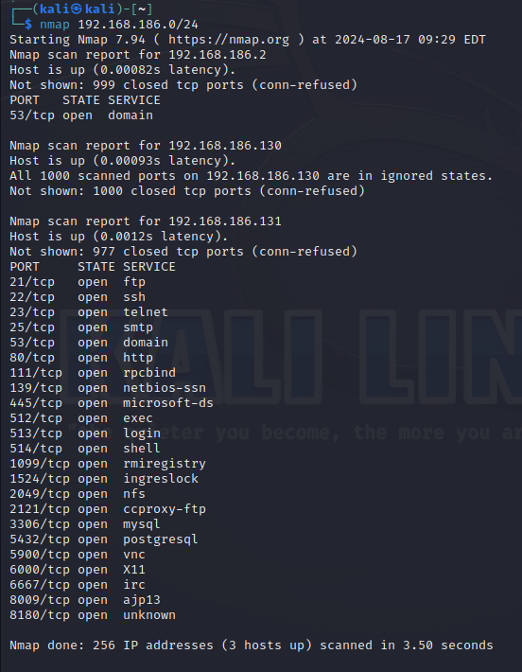
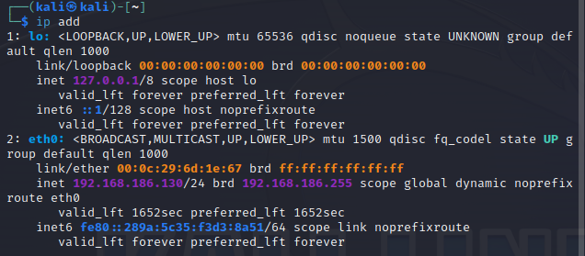
Nmap ➔ specific network
Nmap 192.168.186.0/24 ➔ specific network
IP Address: 192.168.186.0
Subnet mask: /24 → 255.255.255.0
NID: IP Address AND Subnet mask
Host Range: 192. 168.186.1-254

Slide 10
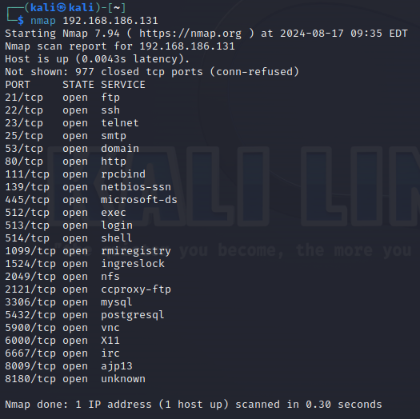
Nmap ➔ specific host
Nmap 192.168.186.131/24 ➔ specific network
Nmap 192.168.186.131/32 ➔ specific host
Nmap 192.168.186.131 ➔ specific host

Slide 11
-p ➔ port
kali
Metasploitable
Syn
80/443
Random
Port
Syn Ack
Host scan
alive
3-way handshake
Nmap 192.168.186.131
Scan the most famous 1000 ports TCP
Nmap 192.168.186.131 –p 80 (figures on the right)
Q: Why was a reset message sent?
Faster + firewall discover
Ack
Open session
RST
Syn
Syn
80
Port scan
Open port
Random
port
3-way handshake
Ack
Open session
RST

Slide 12
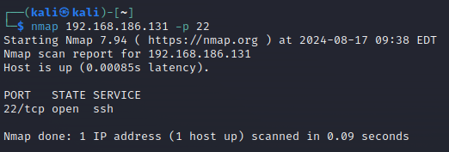
Nmap <ip-address> -p <port #> ➔ port

Slide 13
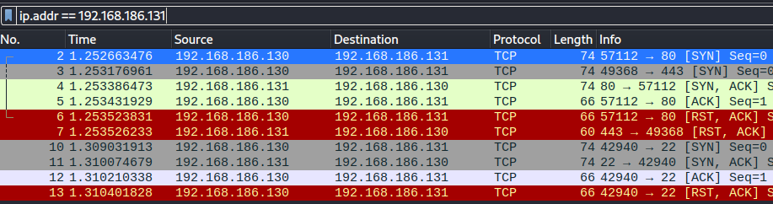
Wireshark
Host Scan ➔ Alive
3-way handshake (80+ 443)
Port Scan ➔ Open
3-way handshake (22)

Slide 14
RST message ➔
Why send RST message?
So that the sender does not have to wait too long.
The sender may think that the message was lost on the way and continue sending messages, high traffic on the network.
kali
windows
Syn
Host scan
Alive
Port scan
closed
80
RST
Port 80 is closed

Slide 15
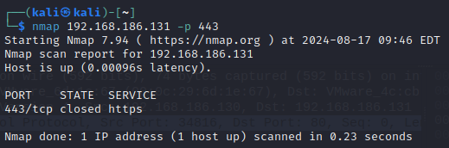
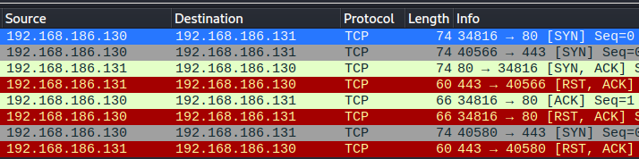
Closed Port

Slide 16
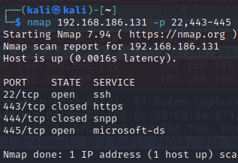
Fixable ip & port
Specific or range of ip or port.
Nmap 192.168.186.130 –p 44-48,55
Port: 44, 45, 46, 47, 48, 55
Nmap 192.168.186.131-133,190 –p 44-48,55
Ip address: .131, .132, .133, .190
Port: 44, 45, 46, 47, 48, 55
Q: why ip 192.168.186.190 is not found?
Devise is not found ➔ datalink layer

Slide 17
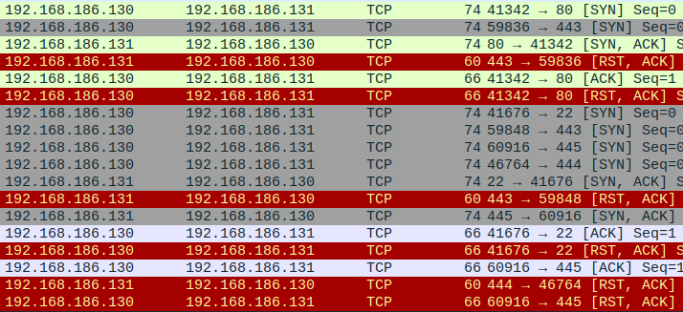

Slide 18
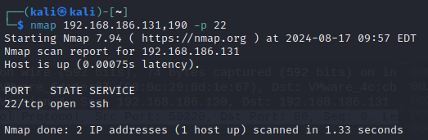
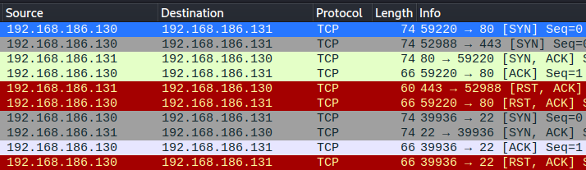
Where is 192.168.186.190?

Slide 19
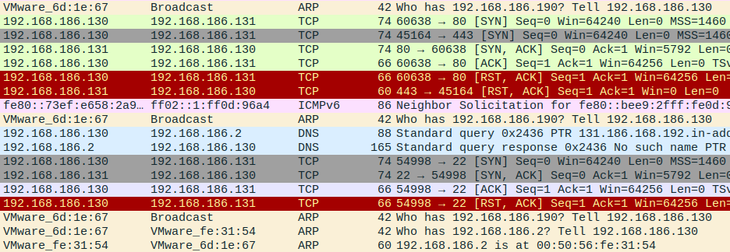
Datalink Layer Problem

Slide 20

-sn ➔ no port scan
kali
Metasploitable
Syn
80/443
Nmap 192.168.186.131 -sn
Host scan
No ➔ Scan 1000 ports
Nmap 192.168.186.131 –p 80 -sn
Host scan
No ➔ One port…..
Error
To check if device is alive only
Fast + low load ➔ hard detect hacker
Random
port
Syn
Host scan
alive
Ack
RST
Syn
Syn
80
Random
port
Port scan
Open port
Ack
RST

Slide 21
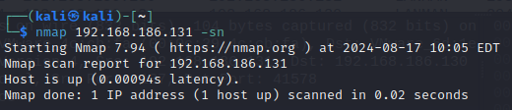
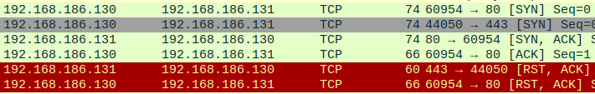
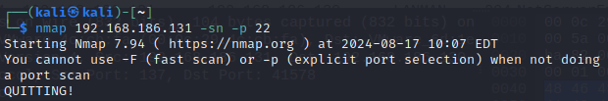

Slide 22
-Pn ➔ No Host Scan
kali
Metasploitable
Syn
80/443
Random
port
Syn
Nmap 192.168.186.131 -Pn
No ➔Host scan
Yes ➔ Scan 1000 ports
Nmap 192.168.186.131 –p 80 -Pn
No ➔ Host scan
Yes ➔ One port
Host scan
alive
Ack
RST
Syn
Syn
80
Port scan
Open port
Random
port
Ack
RST

Slide 23
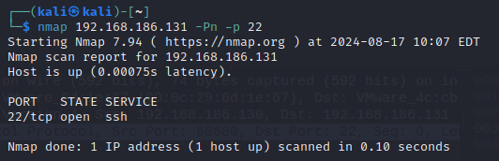
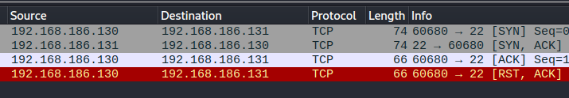
Only
Port Scan

Slide 24
Why Use –Pn?
kali
Metasploitable
Syn
80
Firewall cashed you
Syn
Send to all at port 3306 (mysql server), any response ➔ DB Server.
Host scan
Not found
No response
Syn
kali
Database Server
Syn
Using -Pn
3306
mysql
Syn
Port scan
Open port
+
alive
Random
port
Ack
RST

Slide 25
Full Scan
Half Scan
kali
Metasploitable
kali
Metasploitable
Syn
Syn
80/443
80/443
Random
port
Syn
Random
port
Syn
Host scan
alive
Host scan
Alive
Or
Open port
Ack
RST
RST
Open session ➔ Session ID
Saved at log file inside server

Slide 26
Full Scan
Half Scan
kali
Metasploitable
kali
Metasploitable
Syn
Syn
Closed port
80/443
Closed port
80/443
RST
RST

Slide 27
-sS ➔ only for port scan (need sudo or root) root : no need –sS option
sudo nmap 192.168.186.131 –p 22 –sS
No host scan
Only port scan
sudo nmap 192.168.186.131 –Pn –sS
sudo nmap 192.168.186.131 –sn –sS
kali
Metasploitable
Syn
22
Random
port
Syn
Port scan
Alive
+
open
RST

Slide 28
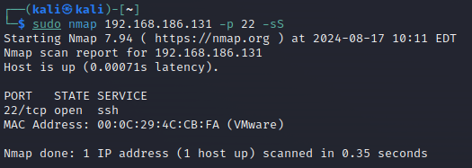
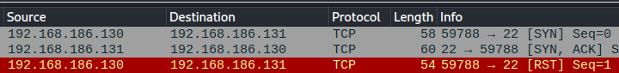
Only
Port Scan
Half Scan

Slide 29
Day 14
Outline
-O → OS Version
-sV → Port Version
-f → fragmentation of the packets
-T → Time
-D → decoy scan
-g → Src Port change
-sT → TCP scan
-sU → UDP scan
-sC → nmap Script
--script → nmap script

Slide 30
Revision
Nmap 192.168.186.0/24 → scan NID
Nmap 192.168.186.131 → scan one device (host + 1000 port most famous scan)
Nmap 192.168.186.131 –p 80 → scan one device (host + port 80 scan)

Slide 31
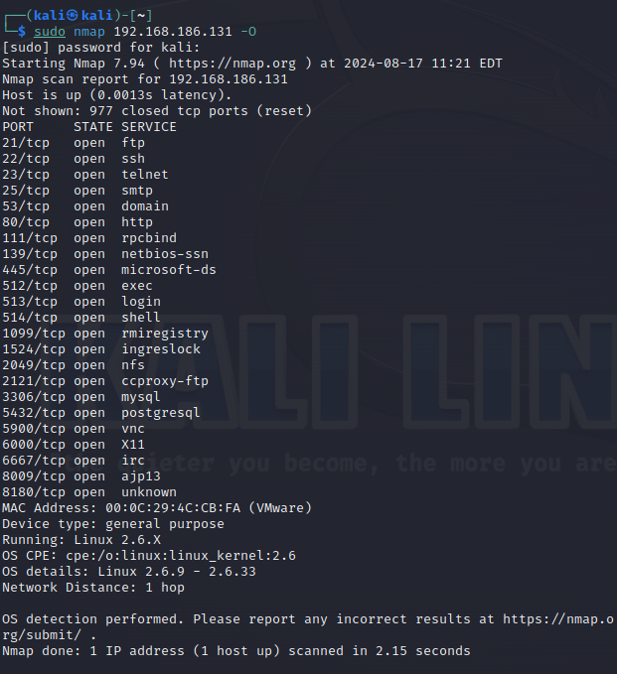
-O → OS version
Q: how to find OS type & version?
TTL
Window size

Slide 32
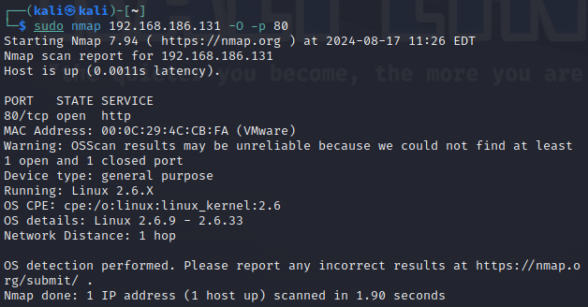
Using -O
Need a lot of time.
Danger, Traffic become un-normal → Firewall will discover you

Slide 33
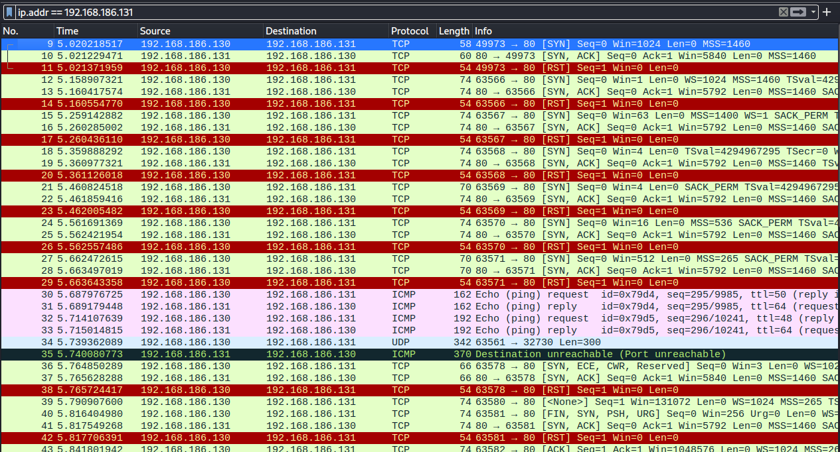

Slide 34
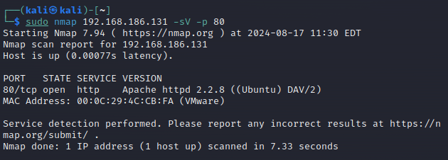
-sV → Port Version
To get version details of HTTP → request the page (more time & data sending throw the network).

Slide 35
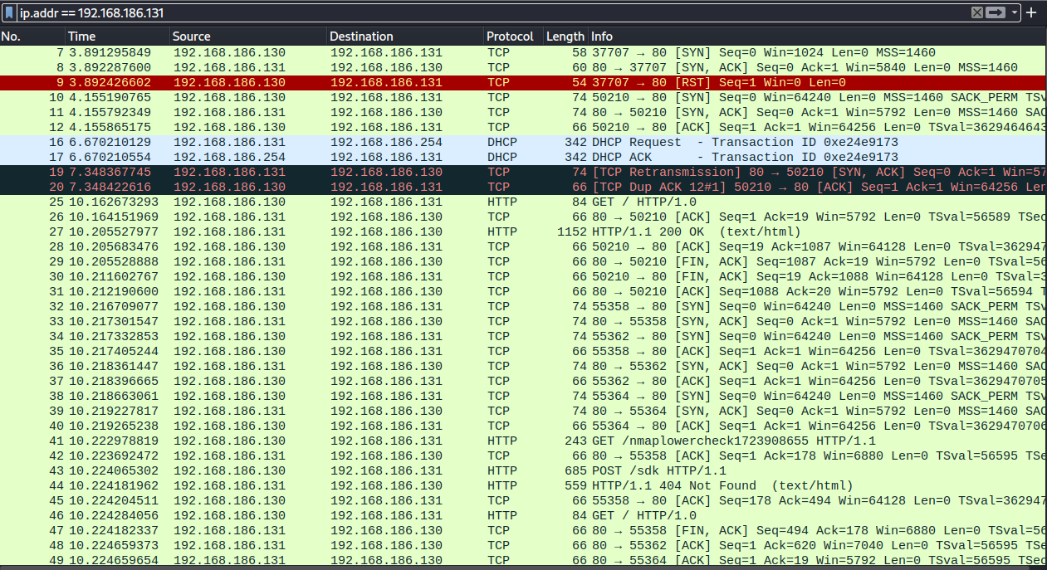

Slide 36

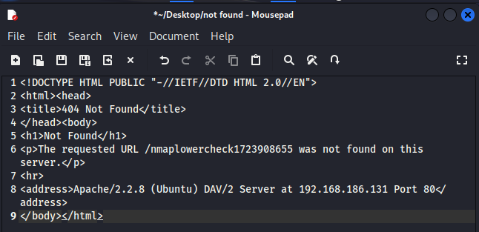

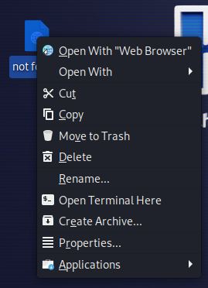
Follow → TCP stream
Data is coming separated, TCP Stream Collects them and give it to you.
Notepad can compile “HTML” language.

Slide 37
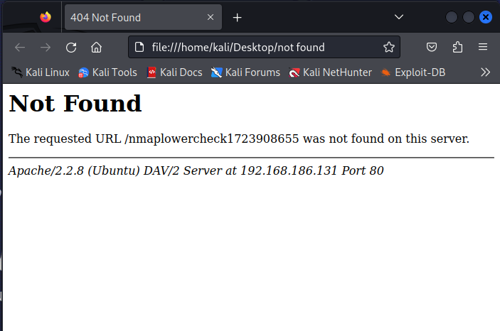
404 Not Found Page

Slide 38


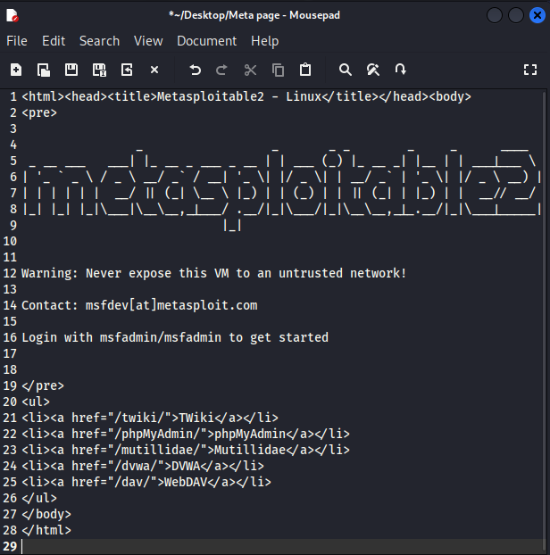

Metasploitable Page HTTP

Slide 39
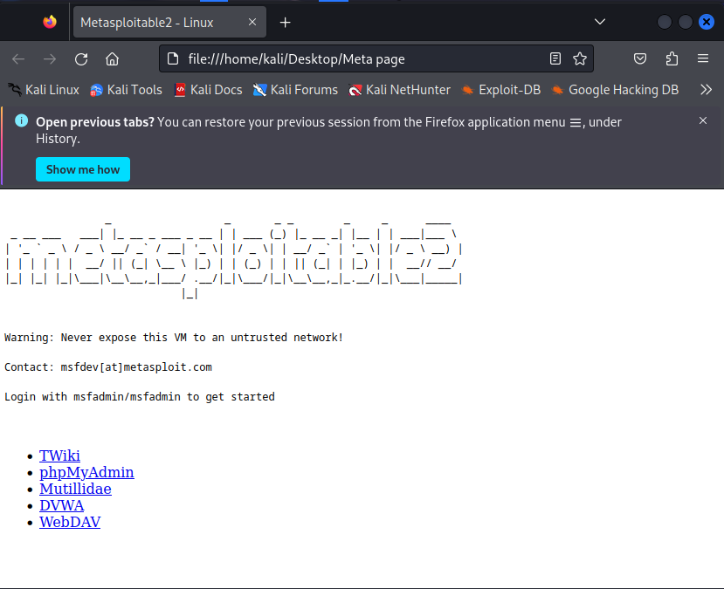
Metasploitable Page HTTP

Slide 40

Apache
Web server (Before Apache)
Web server (After Apache)
File page
File page
Linked
HTTP
HTTP
Closed
Open
Listening

Slide 41
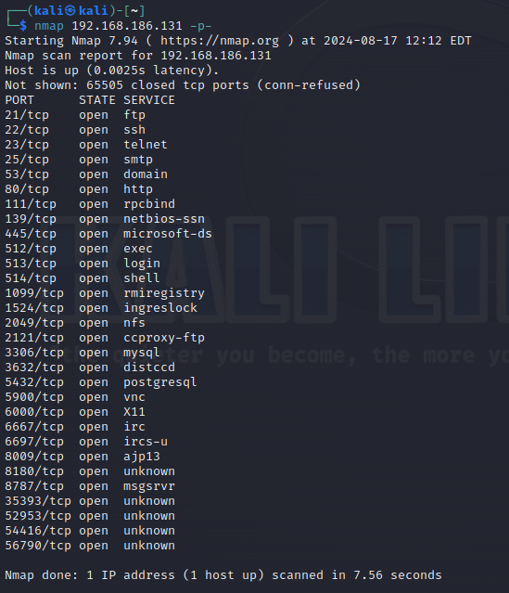
-p- ➔ all TCP ports
Scanning all TCP ports.

Slide 42
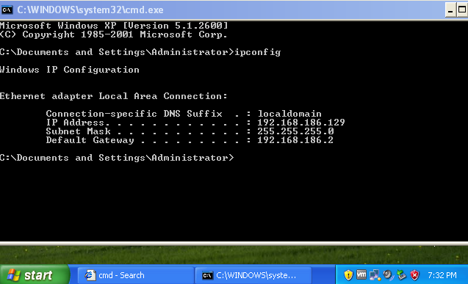
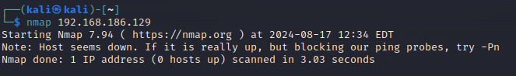
Windows XP ➔ 192.168.186.129
Why kali can’t find windows xp?
In host scan using port 80, firewall know that this is not secure connection so he block it.
Firewall deny open session with port 80.

Slide 43
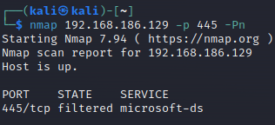
Solution 1 → Use -Pn
With –Pn we skip host scan & direct make the port scan → here at port 445
Port is filtered (there are firewall on it).

Slide 44
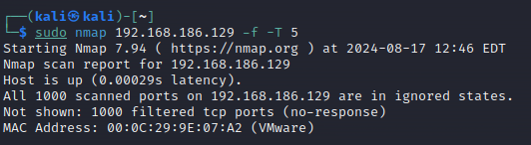
Solution 2 → -T Change behaver
-T → change time between each packet.
Closed port → response reset massage → RST
Filtered port → no response

Slide 45
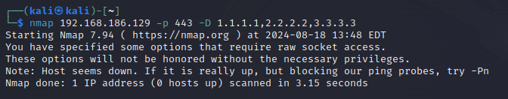
Solution 3 → -D Decoy
Firewall camouflages that there are many devices wanting to communicate with it at the same time, it will not be able to keep up with the traffic and will allow all traffic to enter

Slide 46
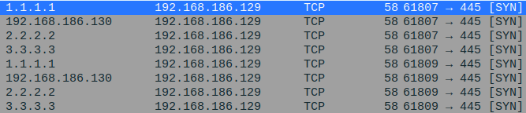
-D → decoy scanning
Q: why we can’t change our IP Address?
Kali will not get any response, the response message it not contain our IP.
-S → fake src ip
Using when we don’t want to get any receive message.

Slide 47
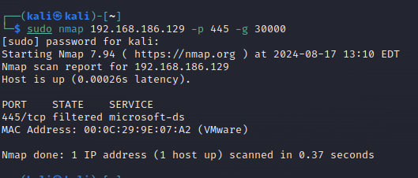
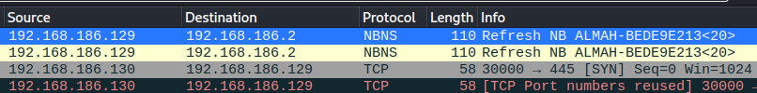
-g → src port
used to specify the source port for the scan
443 is secure port, firewall think that this is a secure connection

Slide 48
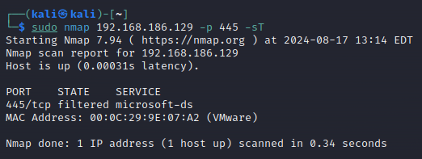
-sT → TCP scan (Default)

Slide 49
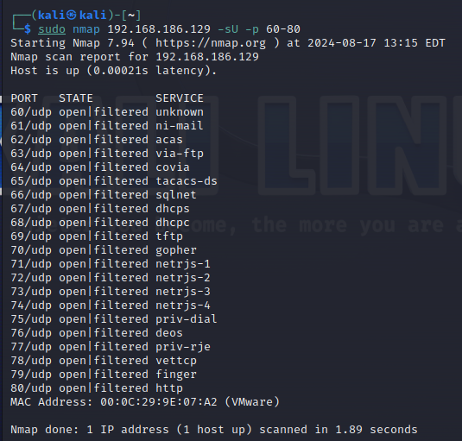
-sU → UDP Scan
perform a UDP scan, UDP is a connectionless protocol, meaning there's no handshake or acknowledgment process. This makes UDP scanning more challenging and slower than TCP scanning.

Slide 50
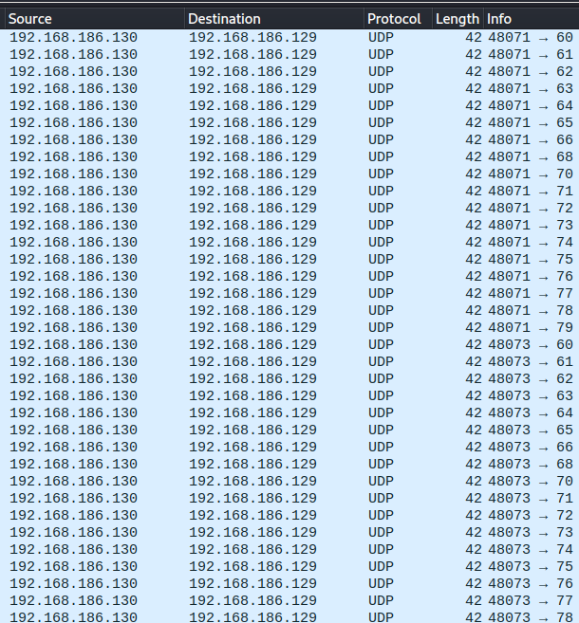

Slide 51
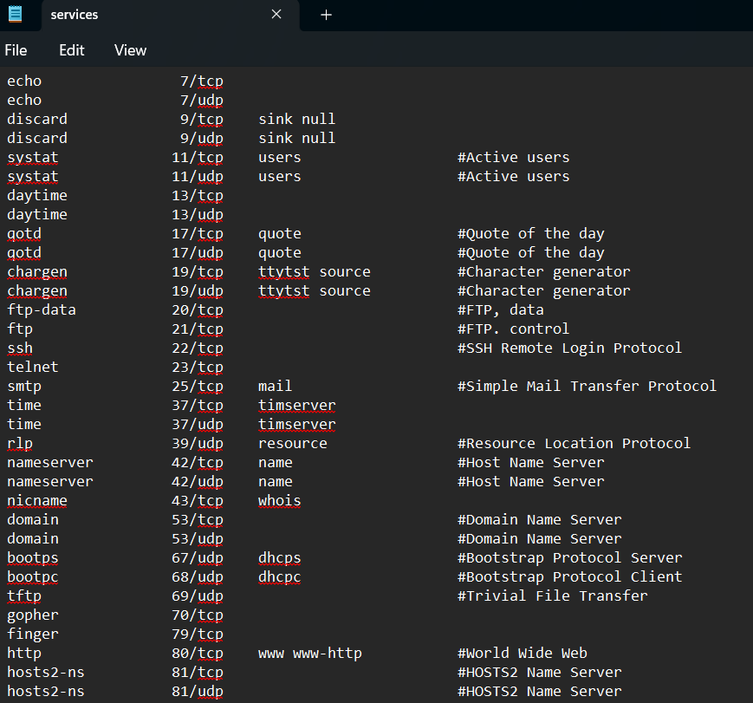
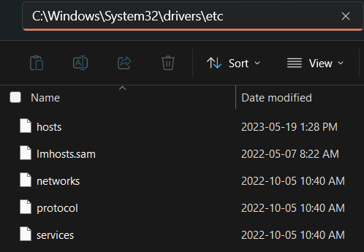
C:/Windows/system32/drives/etc

Slide 52
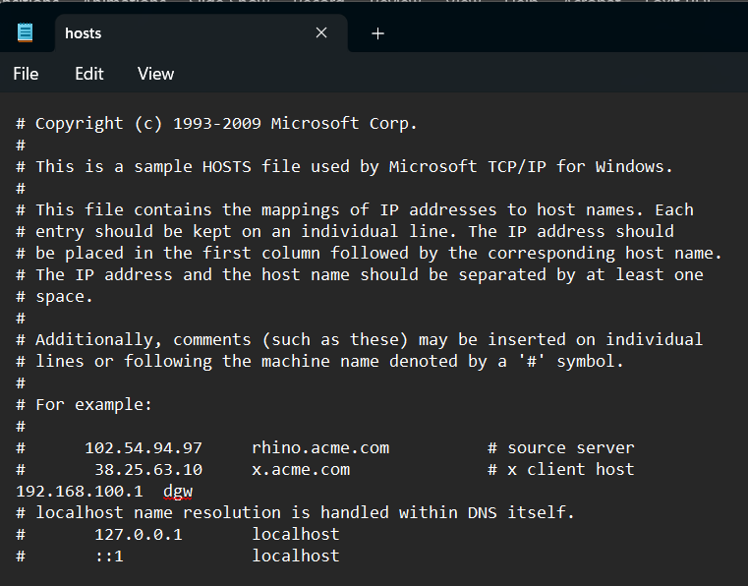
hosts
Hacker can append a fake IP address to make you open the hacker web page.
IP Address DNS
1.1.1.1 www.google.com

Slide 53

-sU –p 67 → DHCP
Ask for a service:
DHCP (DORA)
DHCP Request
DHCP Offer
DHCP Request
DHCP Ack

Slide 54

-sC for Unknown port (8180)
Now you know what is 8180 port is for.

Slide 55


-sC → Script
Use nmap default script to file more details.

Slide 56


-sC → Script

Slide 57

-sC → Script “ /usr/share/nmap/scripts/ ”
The `.nse` file extension is used for Nmap Scripting Engine (NSE) scripts.
These scripts are written in the Lua programming language and are designed to automate a wide range of network scanning tasks within Nmap.
Automation: automate complex tasks, such as vulnerability detection, service enumeration, and even exploitation.
Extensibility: Users can write their own `.nse` scripts.
Efficiency: NSE scripts can be run in parallel with Nmap’s scanning.

Slide 58

Search in nmap scripts

Slide 59

--script
nmap 192.168.186.131 -p 21 -Pn --script ftp-anon.nse
used to specify a script or a set of scripts from the Nmap Scripting Engine (NSE). These scripts can be used to perform a wide range of tasks such as vulnerability detection, backdoor detection, and more.

Slide 60
Day 15
Outline
Metasploit
Msfconsole
Exploit FTP example
Rank level
Msvenom
Binding
Reverse Sessioon

Slide 61
Metasploit
an open-source framework that simplifies the process of finding, exploiting, and validating vulnerabilities in systems. It is widely used by penetration testers, ethical hackers, and security researchers.
Types:
msfconfig
msvenom
Type of Attack:
Binding
Reverse session

Slide 62
Example 1
FTP backdoor:
vsftpd 2.3.4 backdoor, Rank: Excellent
Vulnerable Software: vsftpd 2.3.4
Exploitation: Log in with a username ending with `:)`.
Result: A root shell is opened on port 6200.
nmap -p 21 --script ftp-vsftpd-backdoor <target-ip>

Slide 63

Metasploitable
Create file.txt → password: 1234

Slide 64


Kali
Network scan → nmap 192.168.186.0/24
Device scan → nmap 192.168.186.131
Port scan → nmap 192.168.186.131 –p 21 –sV
Open msfconsole

Slide 65

Search for exploit
Open msfconsole
Find exploit for “vsftpd 2.3.4” → search vsftpd 2.3.4
Disclosure Date ←→ Zero Day, there is no available patch at the time of the attack, which makes these attacks particularly dangerous.

Slide 66
Rank
Excellent: They are the most stable for production environments or penetration testing against live systems.
Great: Suitable for penetration tests but with a bit more caution, especially in production environments.
Good: Typically used in controlled environments like labs or with non-critical systems.
Normal: Suitable for use in testing environments where failures are acceptable.

Slide 67
Rank
Average: Best used in test environments, where the focus is on learning rather than guaranteed success.
Low: Used mainly for testing purposes in controlled environments where instability is expected.
Manual: Best for advanced users who understand the exploit in detail and are willing to do additional work to make it successful.
Average/Below Average: Best for practice in controlled environments where stability is not a concern.

Slide 68

Use the exploit + Show Option
CHOST: Local Client Host IP Address (Source)
CPORT: Local Client Port Number (Source)
RHOST: Target Receiver Host IP Address (Destination)
RPORT: Target Receiver Port Number (Destination)

Slide 69

Set RHOSTS
vsftpd 2.3.4 exploit need receiver IP Address
Q: by default dest port # set to 21?
This is for FTP exploit, where FTP is at port 21.

Slide 70

run
Banner
USER: 331 Please specify the password.
Password: Z
Successfully login
Backdoor service
UserID = 0 → Root User
Rank excellent
Open Session (Re-Directional)
Run Command (ls, pwd, cat, …)

Slide 71
Example 2
MS17-010 is a critical security vulnerability in Microsoft Windows' Server Message Block (SMB) protocol.
EternalBlue is the name of the exploit allows attackers to remotely execute arbitrary code on vulnerable systems.
It enables an attacker to:
Send specially crafted messages to SMBv1.
Cause a buffer overflow.
Gain unauthorized access and potentially execute code without needing to authenticate.

Slide 72


Windows 7

Slide 73

INST. : ENG.ALI BANI BAKAR & ENG.Dana Al-Mahrouk

Slide 74


Slide 75

Once you have access, you can use several Meterpreter commands to interact with the compromised system.
Take a screenshot → screenshot
Check system information → sysinfo
List running processes → ps
Execute commands → execute -f cmd.exe –I
Exit the Session → exit

Slide 76

Rank Average

Slide 77


Slide 78


keyscan_start → start capture the keyboard input
keyscan_dump → display what you capture
keyscan_stop → stop capture the keyboard input
Benefits of `migrate` command:
Stability and Persistence: Long-running processes are ideal targets for migration, less likely to be terminated.
Evasion of Detection: Antivirus and endpoint detection systems scrutinize newly spawned or unknown processes.
Privilege Escalation.
Notes:
The `migrate` command in a post-exploitation context, especially in frameworks like Metasploit, offers several key advantages beyond just ensuring the stability of the session. Here are the main benefits of using the `migrate` command:
### 1. **Stability and Persistence**
- The initial process that you exploit (such as the `smbd` service in the case of MS17-010/EternalBlue) may not be a stable or long-running process. By migrating to a more stable process like `explorer.exe`, you reduce the chance of your session crashing if the initial process is stopped or restarted.
- Long-running processes (such as `explorer.exe`, `svchost.exe`, or `lsass.exe`) are ideal targets for migration, as they are less likely to be terminated.
### 2. **Evasion of Detection**
- Migrating your payload to a legitimate, commonly used system process (e.g., `explorer.exe`) helps evade detection by security tools and system administrators. Suspicious activity tied to a system process is less likely to trigger immediate alerts than if it were running in a less common or short-lived process.
- Antivirus and endpoint detection systems scrutinize newly spawned or unknown processes. Migrating to a known process can help you blend in with legitimate activity.
### 3. **Privilege Escalation**
- Migrating to higher-privileged processes (e.g., `lsass.exe` or `svchost.exe`) can grant the attacker elevated privileges on the system. This may allow you to access more sensitive data or perform administrative tasks that would otherwise be restricted.
- For example, by migrating into `lsass.exe`, you may gain access to password hashes or other sensitive credentials stored in memory.
### 4. **Avoiding Process-Specific Limitations**
- Some processes might have restricted privileges or run in a sandbox environment that limits what the attacker can do. Migrating to a less restricted process can open up more avenues for post-exploitation activities.
- For example, the initial exploit might drop the payload in a service with network restrictions, but migrating to a different process might remove those limitations and give you full network access.
### 5. **Avoiding Termination**
- If the initial exploited process crashes or is manually restarted by an admin, it would terminate your session. Migrating to a more stable or less scrutinized process can help you avoid this and maintain control over the compromised machine.
- For example, the `smbd` service might be restarted as part of regular maintenance or as part of security practices, which would kill your session if you hadn't migrated.
### 6. **Bypassing Security Tools**
- Some security tools may attempt to automatically kill or quarantine suspicious processes. By quickly migrating to a trusted system process, you can potentially bypass these automatic defense mechanisms.
- This is especially useful in environments where automated responses are set up to terminate newly spawned processes that aren't recognized by the system's whitelist.
### 7. **Minimal User Disruption**
- Migrating into processes like `explorer.exe` allows the attacker to hide in processes tied to user activities without causing noticeable system instability or crashes, reducing the chance of the user becoming suspicious.
- Processes such as `explorer.exe` are integral to the user interface, so they are unlikely to be closed by users or admins, making them ideal for hiding malicious activity.

Slide 79
Open another session
you can open multiple Meterpreter sessions with a victim using Metasploit, provided the victim machine allows multiple connections and the network or system's security hasn't blocked your access.
Background → put your session to run at background
Run → run a new session with the victum

Slide 80


Slide 81


Netstate –n → displays active “TCP/IP connections” and listening ports on a system.
-n → Displays IP addresses and port numbers in numeric form
Connection State:
ESTABLISHED: A connection is open and data is being transmitted.
TIME_WAIT: A connection is waiting to close after being terminated.
CLOSE_WAIT: The connection is closed on the remote side but still open on the local side.
LISTEN: The system is waiting for an incoming connection on that port.

Slide 82

Connection State:

Slide 83







Reverse Session
remote access types:
Bind Shell (Bind Session): the victim opens a port and listens for an incoming connection. The attacker connects to this open port to control the target.
Firewalls on the target machine may block the listening port, preventing the attacker from connecting.
Reverse Shell (Reverse Session): the attacker’s machine listens for an incoming connection. The victim connects back to the attacker.
where the “victim’s firewall” is blocking inbound traffic but allows outbound traffic.
Binding
Hacker
Firewall
Victim
Reverse Session
Hacker
Firewall
Victim
payload

Slide 84



Ex3 Payload
In the case of reverse shells, the payload is the code that, when executed on the victim's machine, establishes a connection back to the attacker's machine, allowing for remote command execution.
Reverse Session
Hacker
Payload
Victim
payload
Hacker
Firewall
Victim
payload
The hacker creates the program according to the type of program and the type of the victim's device, and places the hacker's device data so that this program can communicate with him later.
The program reaches the victim's device, either by phishing via email, a malicious USB, or a malicious link from a site
When the victim runs the program, the victim starts communicating with the hacker, bypassing all firewall policies. The hacker receives all the data he wants and can control the victim's device as well.

Slide 85


Slide 86


Slide 87


Slide 88


Slide 89


Slide 90


Slide 91



Slide 92


Slide 93
Day 16
Outline
Kernal functions
Process & Service
OS
SSH
telnet vs ssh
Example using GNS3

Slide 94




Kernal
The kernel is the core component of an operating system (OS) that manages a computer's hardware and software resources. It acts as a bridge between the hardware and the applications, providing a platform for them to interact.
Process Management
- Creates, manages, and terminates.
- Allocates memory to processes.
Communication With Machine
- Provides a standardized interface for applications to interact with devices.
- Handles device interrupts and scheduling.
File Management
- Creates, deletes, and modifies.
- Provides a hierarchical structure for organizing files.
Task Scheduling
- Handles system timers and scheduling.

Slide 95
Process Management
Hard disk
RAM
CPU
RAM
Foreground
P4
P1 Stopped
Run
P5
P4 Running
Process ID 1 (Firefox)
Firefox
P6
P5 Running
Kill
Ctrl + C
Ctrl + Z
P2 Waiting
bg %...
Background
fg %...
P6 Running
Running
Stopped
P3 Waiting
&
P7 Running

Slide 96
Process VS Service
Feature | Process | Service
Definition | A running instance of a program or task. | A background process that performs system tasks or provides functionality
Start Trigger | Manually by a user or program. | automatically at system boot or manually by an administrator.
Interaction | May interact with the user | Usually no direct user interaction; instead, managed via tools
Purpose | Executes specific user or system tasks. | Provides ongoing, system-level functions (e.g., printing, web hosting, network services).
Lifespan | short-lived | long-running
Visibility | visible to users and listed in the Task Manager | hidden from direct user view
Resource Usage | May consume significant CPU, memory, etc. | Generally optimized for low resource usage
Failure Handling | terminate if an error occurs, and the user must restart it. | restart automatically if they fail or encounter an error.

Slide 97


Process

Slide 98

Service
Running Services which has running process → PID

Slide 99
Kernal VS Application
Kernel: OS’s brain, controlling the body (hardware) and ensuring everything functions as intended.
Application: The tools or apps you use every day, like browsers, games, or word processors, which rely on the brain (kernel) to work.
Application
User
Mode
Other OS Feature
File System Management
Process Management
Kernal
Mode
Memory Management
Input Output Management
Concurrency
Device Management
Hardware

Slide 100
Kernal VS Application
Feature | Kernel | Application
Definition | The core component of an OS that manages HW resources and facilitates communication between HW & SW. | Programs designed to perform specific tasks for the user, running on top of the OS.
Role | Manages low-level tasks like CPU scheduling, memory management, file systems, and hardware communication. | Provides a user-friendly interface and tools for accomplishing specific tasks.
Level | system level, interacting directly with hardware. | user level, interacting with the kernel for hardware access.
Execution Mode | privileged mode (kernel mode) | Runs in user mode

Slide 101



Telnet VS SSH
Telnet
both network protocols used to access and manage remote devices, such as servers or routers.
Feature | Telnet | SSH
Layer | L7 App | L7 App
Port | 23 TCP | 22 TCP
Encryption | No encryption | Full encryption
Text | plain text (clear text) | Cipher text
Security | Insecure → MITM | Secure
Configuration | Simple | More complex
Usage | testing connectivity, communicating with older devices | securely managing and configuring servers or network devices
Client (controller)
Server
SSH
Client (controller)
Server

Slide 102

SSH GNS3-Lab
Steps:
Set IP Address + Subnet Mask + Turn On Interface
Set Hostname and Domain Name
Generate RSA Key for SSH (512 – 1024 bits)
Show Crypto Key
Configure Username and Secret Password (local user account “Dana” with the secret password “123”)
Configure VTY (Virtual Teletype) Lines for SSH Access
R1
R2
SSH Server
Client

Slide 103
Set IP Address + Subnet Mask + Turn On Interface
f0/0
f0/0
R1#configure terminal
R1(config)#interface fastEthernet0/0
R1(config-if)#ip address 192.168.0.1 255.255.255.0
R1(config-if)#no shutdown
R1(config-if)#do write
R2#configure terminal
R2(config)#interface fastEthernet0/0
R2(config-if)#ip address 192.168.0.2 255.255.255.0
R2(config-if)#no shutdown
R2(config-if)#do write
R1
R2
192.168.0.1
192.168.0.2

Slide 104



2. Set Hostname and Domain Name 3. Generate RSA Key for SSH (512 – 1024 bits)
f0/0
f0/0
R1(config)#hostname Dana
Dana(config)#ip domain-name bau.edu.jo
Dana(config)#crypto key generate rsa encryption
The name for the keys will be: Dana.bau.edu.jo
Choose the size of the key modulus in the range of 360 to 4096 for your
Encryption Keys. Choosing a key modulus greater than 512 may take
a few minutes.
How many bits in the modulus [512]: 512
% Generating 512 bit RSA keys, keys will be non-exportable...
[OK] (elapsed time was 0 seconds)
Dana
R2
192.168.0.1
192.168.0.2
DNS: bau.edu.jo

Slide 105
4. Show Crypto Key
f0/0
f0/0
Dana
R2
192.168.0.1
192.168.0.2
DNS: bau.edu.jo
% Key pair was generated at: 16:31:56 UTC Sep 19 2024
Key name: Dana.bau.edu.jo.server
Key type: RSA KEYS
Temporary key
Usage: Encryption Key
Key is not exportable.
Key Data:
307C300D 06092A86 4886F70D 01010105 00036B00 30680261 00931588 65BA8233
8120EDF5 3DAE192A 1904CE6F E2AC1B65 FE2B2DE4 16BC7AF2 2040D8E6 90A317FF
2020489D 3209B87C 2BD38EA7 1D08D86A 53CDF5A5 79CD37D1 83510A09 388B8682
D3EC93C8 CFCC0E4F 62202608 581B70AD 433CA255 903F183F F7020301 0001
Dana(config)#do show crypto key mypubkey rsa
% Key pair was generated at: 16:31:55 UTC Sep 19 2024
Key name: Dana.bau.edu.jo
Key type: RSA KEYS
Storage Device: not specified
Usage: Encryption Key
Key is not exportable.
Key Data:
305C300D 06092A86 4886F70D 01010105 00034B00 30480241 009E2C19 FE60CFAC
7CAACE4A 44B1C245 D4EB6423 174528FB 2CC44F3E 91EEA917 9A6A5140 F906439E
C26BCBB0 A69458CB 945841F0 9632AC77 B10A082A 49C5CD59 83020301 0001

Slide 106
5. Configure Username and Secret Password
VTY SSH local user
Password → 123
Dana(config)#username Dana secret 123
Dana(config)#enable secret zinc
Dana(config)#line vty 0 4
Dana(config-line)#login local
Dana(config-line)#transport input ssh
f0/0
f0/0
Dana
R2
192.168.0.1
192.168.0.2
6. Configure VTY Lines for SSH Access
DNS: bau.edu.jo
Secret Password → zinc
Privilege Model #

Slide 107
7. Connection with Dana(R1) Router using SSH
R2#ssh -l Dana 192.168.0.2
Password: <123>
Dana> en
Password: <zinc>
Dana#

Slide 108


Slide 109
Day 17
Outline
Reconnaissance (Active, Passive)
Shodan
Ethernet VS Serial Cables
Google Search Console
Have I Been Pwned
Virus Total
Lab: Change Default HTTP Port
John
Brute Force, Dictionary, and Rule-based Attack

Slide 110
Reconnaissance (Active Passive )
involving the gathering of information about a target system, network, or organization.
Passive Reconnaissance: Collect information about the target without directly interacting with it.
Advantages: Stealthy and difficult to detect, minimizing the risk of alerting the target.
Disadvantages: Limited in-depth information since no direct interaction with the target is performed.
Active Reconnaissance: Actively interact with the target to gather more detailed information.
Advantages: Provides more accurate and detailed information.
Disadvantages: Likely to be detected by the target’s security systems, increasing the risk of being blocked or flagged.

Slide 111








Passive Reconnaissance
gathers information about a target system, network, or organization without directly interacting with the target.
Social Media and Online Forums → (Reading company-related posts or personal employee data.)
WHOIS Lookups→ domain, IP addresses, nameservers
DNS Queries → domain's DNS records
Public File Repositories → public code repositories, internal documents
Website Analysis → technologies used in a website, such as the server, framework, or content management system (CMS)
Shodan and Censys → connected devices and services with internet, network infrastructure, open ports
No Direct Communication with victim
Hacker
Victim

Slide 112






Active reconnaissance
is the process of gathering information about a target by directly interacting with its systems, networks, or devices.
This process is more intrusive and may trigger alarms in the target's security systems, so attackers often perform it carefully to avoid detection.
Network & Port Scanning → map out devices, routers, switches, and network infrastructure. IP address discover open ports, services.
Vulnerability Scanning → known vulnerabilities, misconfigurations, and weaknesses that could be exploited.
OS Fingerprinting → OS of the target based on its network behavior, TCP/IP stack responses, and packet analysis.
Traceroute → revealing intermediate routers and potential network structures
Direct Communication with victim
Hacker
Victim

Slide 113
Shodan
indexes the details of internet-connected devices like servers, routers, webcams, industrial control systems, and IoT devices. It scans the internet and collects information about these devices, such as their IP addresses, open ports, protocols, and services they are running.
country:"JO" city:"Amman" port:445
hostname:"example.com“
os:"Windows 10“
product:"Apache httpd“
vuln:"CVE-2023-12345“ → Search for devices with known vulnerabilities (CVEs)
isp:"Orange“ → Internet Service Provider (ISP)
Notes:
Windows
Find My Public IP Address ➔ Invoke-RestMethod -Uri http://ifconfig.me
Find My Open Port ➔
netstat -an | findstr LISTEN
OR
Get-NetTCPConnection | Where-Object { $_.State -eq "Listen" }
Linux
IP Address ➔ curl ifconfig.me
Open Port ➔ netstat -tuln

Slide 114


Slide 115



Ethernet VS Serial Cables
An Ethernet cable is used to connect devices in a local area network (LAN), such as computers, routers, switches, and modems.
A Serial cable is used to transfer data between devices via serial communication, which means data is sent sequentially one bit at a time. It is commonly used to connect devices like modems, older computers, networking equipment (like routers and switches)
Feature | Ethernet | Serial
Speed | 10 Mbps – 100 Gbps | 56 Kbps – 2 Mbps
Interface Type | Twisted Pair | Smart Serial
Usage | LAN - WAN | WAN – Long distance
Communication | Full-duplex | Often Half-duplex
Distance | ~ 100 m | ~ Km

Slide 116



Ethernet Cable
 | Vulnerabilities | Attacks | Solutions
1 | (LAN) Vulnerabilities | insider attacks | VLAN
2 | physical access | Traffic Sniffing | use Encryption when communication → IPsec, SSL/TLS, or MACsec
3 | shared environment | MITM, ARP spoofing | Dynamic ARP Inspection (DAI) & Port Security
4 | No proper segmentation | DDoS, broadcast storms | firewalls & intrusion prevention systems (IPS)
Firewall

Slide 117
Google Search Console
site: www.bau.edu.jo
site: .bau.edu.jo
site: .bau.edu.jo - www.bau.edu.jo
filetype: pdf “Cybersecurity”
site: .edu.jo filetype: pdf “AI”
inurl: Microsoft
filetype: jpg “artificial intelligent”

Slide 118
Have I Been Pwned
"Have I Been Pwned" is a website that allows you to check if your email address or accounts have been involved in data breaches. When you enter your email, it searches its database of known breaches and lets you know if your information has been exposed. It can help you take action, like changing passwords or securing accounts, to protect your online presence.

Slide 119


Slide 120

VirusTotal
VirusTotal is a free online service that analyzes files and URLs to detect malware and other security threats using multiple antivirus engines and tools. You can upload a file or enter a URL, and it will provide a detailed report on whether any of the security tools flagged it as malicious. It's a useful resource for checking the safety of files and websites before interacting with them.
While VirusTotal can be helpful, it's important to consider that uploading sensitive or private files may expose them to third parties. If you have data that is particularly sensitive or confidential, it's generally best to avoid sharing it with any online service.
For secure file analysis, consider using local antivirus tools or solutions that allow you to analyze files without uploading them to the cloud. Always prioritize privacy and data security!

Slide 121


Slide 122


Lab: Change Default HTTP Port

Slide 123

Display the port# of Apache Server

Slide 124


Sudo Nano Apache lessening Port (80 → 50000)

Slide 125

No Connection → http://192.168.186.131:80

Slide 126

Successfully Connection With Port 50000

Slide 127



Slide 128

Vmware in GNS3
This is useful for running operating systems alongside routers, switches, and other network devices in GNS3 labs.
Make sure that Vmware image is turn Off and take place at tha right path:
C:\Users\<username>\Documents\Virtual Machines
For Routers:
C:\Users\<username>\GNS3\images\IOS

Slide 129



Network Adapter
is a hardware component or virtual interface that connects a computer or device to a network, enabling communication with other devices and access to the internet.
Types:
Ethernet Adapter (Wired) → physical separate PCI/USB card.
Wireless Adapter (Wi-Fi)
USB Network Adapter
Fiber Optic Adapter
Virtual Network Adapter → emulates a physical network interface, allowing VMs to connect to virtual or physical networks.

Slide 130


Network Adapter
Virtual Switch
in VMware
Modes
Bridged → connects directly to the physical network
NAT → VM shares the host machine’s IP address through Network Address Translation.
Host-Only → VM can only communicate with the host and other VMs in the same virtual environment.
Internal → can connect only to other VMs on the same host without access to external networks.
NID: 192.168.186
Kali
Windows 7
Ubuntu
Metasploitable
.134
.133
.128
.131

Slide 131

John
is a popular open-source password cracking tool primarily used for password recovery and security testing. It works by performing brute force attacks, dictionary attacks, or hybrid attacks on password hashes to reveal the plaintext passwords.
sudo gzip -d /usr/share/wordlists/rockyou.txt.gz
touch password.txt
kali → d6ca3fd0c3a3b462ff2b83436dda495e
pass → 1a1dc91c907325c69271ddf0c944bc72
123 → 202cb962ac59075b964b07152d234b70
john --format=Raw-MD5 --wordlist=/usr/share/wordlists/rockyou.txt password.txt
rm -r .john

Slide 132




Brute Force, Dictionary, and Rule-based Attack
Brute Force Attack
Dictionary Attack
Rule-based Attack
by systematically attempting all possible combinations of passwords until the correct one is found.
Trying every possible combination of characters (e.g., a-z, A-Z, 0-9, special characters).
relies on using a predefined list of words to guess passwords.
Common passwords:
(like "123456" or "password“)
Variations of words
(like "password1," "Password123").
modifies or enhances dictionary attacks by applying specific rules to generate password candidates based on a known dictionary of words.
name
email
birthday
Phone NO.
aaa
aab
aac
aad
...
pass
1234
login
admin
Name/MM/YYYY
Name&NO.&MM
111
112
113
114
...
Pa$$w0ld
123456789
root
Name@email
...
Name@YYYY

Slide 133
Thank You

